Slide 1
Power Bi
i. If statement on handling colours on tables
ii. Using Hex codes in colouring the charts
iiI. Symbol Map and handling colouring codes
iv. Filled Map and properties
v. Multirow cardi
vi. Funnel Chart
vii. Waterfall Chart
Vii. Introduction to slicers and its basic uses

Slide 2
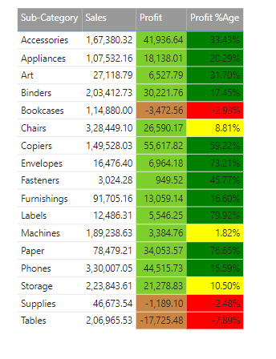
If statement on handling colours
Profit Clr = if(SUM(Orders[Profit]) >= 0 , "green","yellow")
Profit %Age Clr:
Profit %Age Clr = if([Profit %Age] >= 0 , "green","red")
Profit %Age Clr = if([Profit %Age] >= 0.50 , "green", if([Profit %Age] <0, "red", "yellow"))

Slide 3
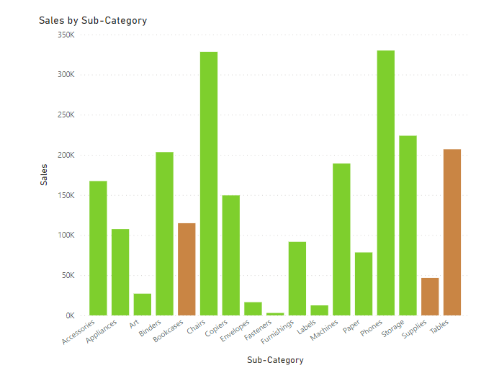
Using Hex codes in colouring
Profit Clr = if(SUM(Orders[Profit]) >= 0 , "#7ecf2d","#c98544")

Slide 4
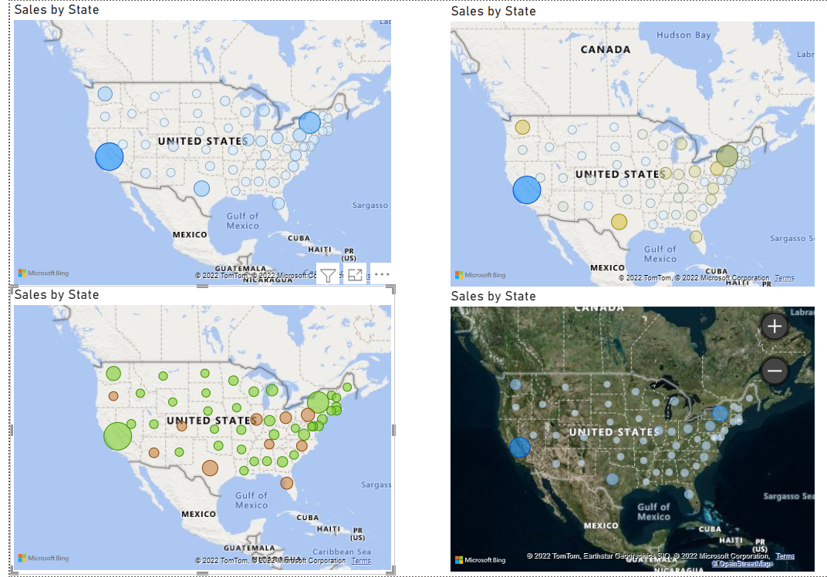
Map and handling colouring codes

Slide 5
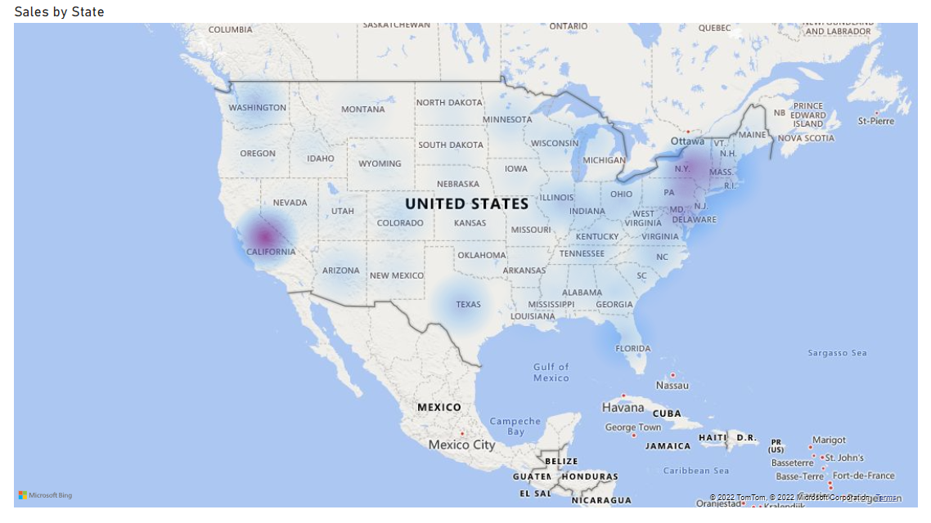
Heat Map

Slide 6
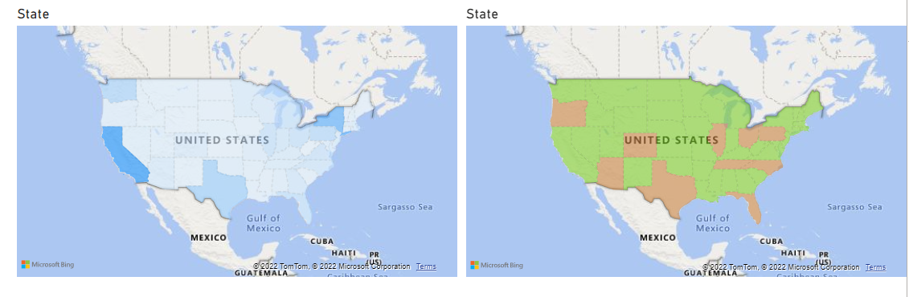
Filled Map and properties

Slide 7
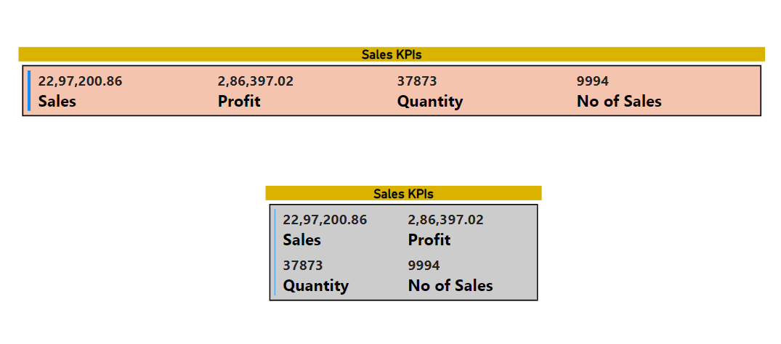
Multirow card

Slide 8
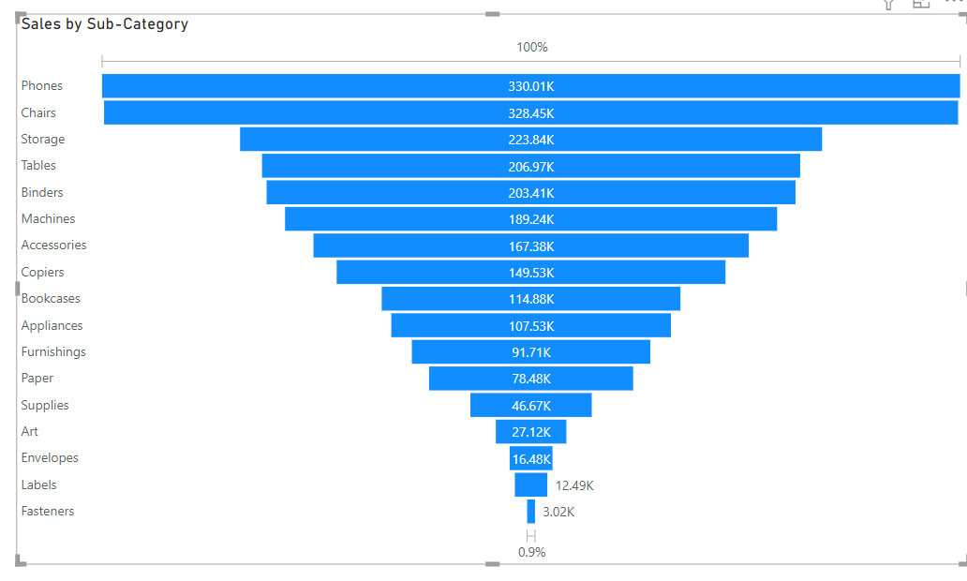
Funnel Chart

Slide 9
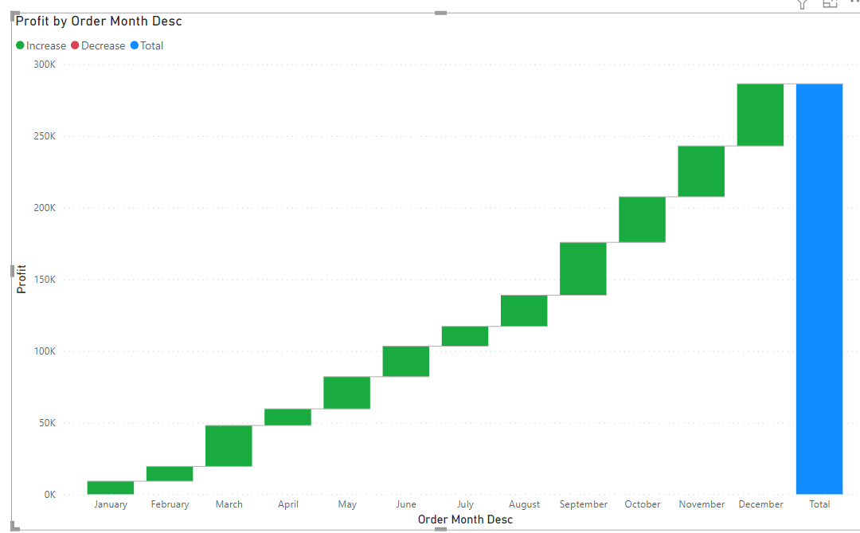
Waterfall Chart

Slide 10
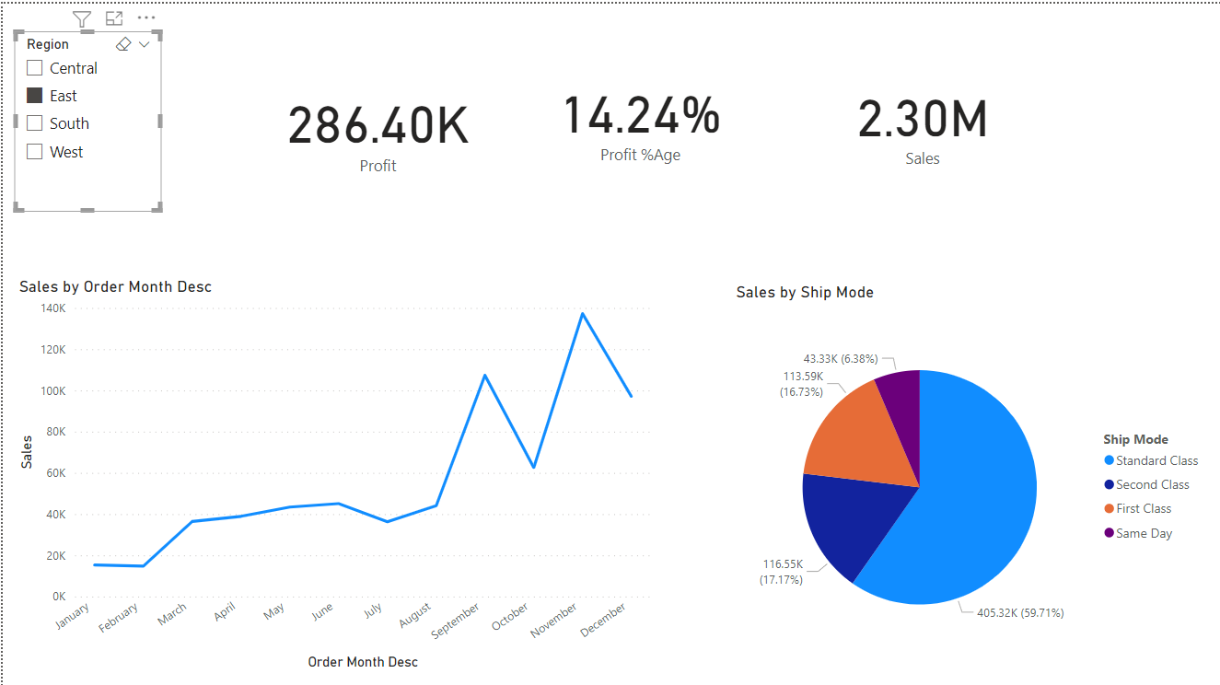
Introduction to slicers and its basic uses properties and handling interactivity with slicer

